Slide 2
Herbert Protocol Learning Event A/DI Matthew Rees Missing Persons Coordinator
Cumbria Constabulary

Slide 3
Agenda
What is the Herbert Protocol
Where to find the form
Registration Process
How is the information utilised
The Forcer Protocol

Slide 4
What is the Herbert Protocol
The Herbert Protocol

Slide 5
What is the Herbert Protocol
Opportunity to safeguard vulnerable persons suffering from dementia
For use by Family, Friends, Carers and the Police
Proactive safeguarding opportunity
Assists agencies in identifying key lines of enquiry should a vulnerable person suffering with dementia be reported missing

Slide 6
Where to find the form
Digital database provided by safe and found online
Friends, family and carers can submit a form as a proactive safeguarding measure

Slide 7
Registration Process
Safe and found online account (www.safeandfoundonline.co.uk)
Provide key information regarding the vulnerable persons including descriptions, locations, medication.
Images can be uploaded
Information can be updated at any time

Slide 8
How is the information utilised
On reporting a persons missing, police will ask if the individual suffers from Dementia
Police have live access to the safe and found database and can immediately access the information provided
Used to inform key lines of enquiry and direct resources

Slide 9
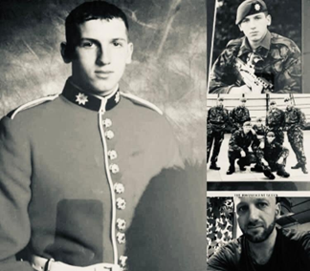
The Forcer Protocol
Its aim is to reduce the risk of harm to service veterans, reservists and currently serving members of the armed forces who go missing
www.safeandfoundonline.co.uk
Enabling swift access to key information that can help the police find the person more quickly

Slide 10
www.cumbria.police.uk
Search : Vulnerable People at risk of going missing

