Slide 1


Slide 2
Mental Capacity Act 2005 and Safeguarding
Focus on assessing Mental Capacity with people who:
Face multiple disadvantages including homelessness;
Have challenges with executive functioning and/or fluctuating capacity
Notes:
Introduce self- OT, APL and new BIA.
This CSAB Forum will focus on the Mental Capacity Act, specifically assessing capacity linked with fluctuating capacity and executive functioning.
I am not an expert- but will share some information and then we have break out rooms planned to support further discussion.

Slide 3
Welcome
Participate fully – your experience adds value to the discussion
Confidential – Share learning and ideas, not personal details
Remain Respectful – different perspectives are welcome
Stay Curious – ask questions, explore assumptions
Notes:
This forum is open to colleagues from lots of different agencies across the Cumbria Footprint, please be kind and respectful of each other and each other’s different roles and experience.
This Forum is set up to be a safe, confidential space. Please turn your cameras on if you can as this helps us connect and do contribute as this makes the session much more meaningful. Any case discussion or discussion around sensitive or identifiable information is confidential and must not be shared outside the session/group.
The format of the session will be for me to share some information, including using Polls and sharing a short video, there will then be time for discussions and reflections within smaller groups.
If you can, have a phone handy which can read QR codes, but don’t worry if this isn’t possible as I realise not everyone will have access to one.
We will send a copy of the slides and all the links and references are included.

Slide 4
Session outline
Recap on the purpose of the MCA and 5 principles
Recap on assessing mental capacity- the functional test and causative nexus
Case studies and break out rooms to support further in-depth discussion
Notes:
We will:
Recap on the purpose of the MCA and 5 principles
Recap on assessing mental capacity- the functional test and causative nexus
Case studies and break out rooms to support further in-depth discussion
It is a bit if a whistle stop tour as the MCA is a massive subject- so I have tried to focus on the most pertinent information to support discussions in the break out rooms.

Slide 5

The purpose of the MCA
Notes:
The Mental Capacity Act received Royal Assent in 2005
The House of Lords review of the Mental Capacity Act called it a, “visionary piece of legislation for its time, which marked a turning point in the statutory rights of people who may lack capacity”
The MCA is a statutory framework that sets out how to assess someone’s capacity to make a decision. If a person is found to be lacking mental capacity to make a specific decision, it sets out how a decision can then be made on their behalf. It applies to people over the age of 16.
Prior to the Act, assessments were often based on someone’s diagnosis or unrelated tests such as a Mini Mental State Examination (MMSE) or maybe an IQ test. The Act clearly sets out how mental capacity should be assessed and how decisions should be made in their best interests.
VIDEO – Alex Ruck Keene KC from 39 Essex chambers explaining the key purpose of the MCA
*****Ask the group - The MCA has five statutory principles which must be adhered to. Can you name what any of these are? The wording doesn’t have to be perfect! – Next slide

Slide 6



Do not edit How to change the design
What are the five principles of the Mental Capacity Act?
The Slido app must be installed on every computer you’re presenting from
Notes:
Joining link: https://app.sli.do/event/kELJVkGTYKHuBiHghxwtJq

Slide 7
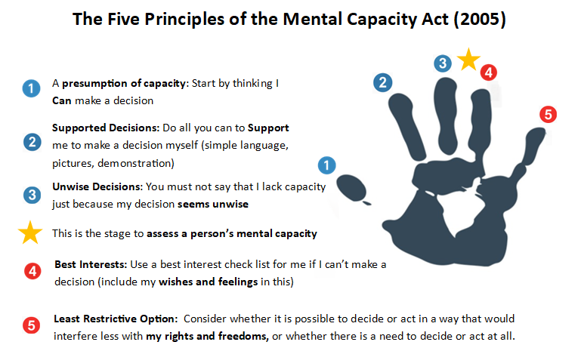
Notes:
The core statutory principles of the Mental Capacity Act are set out in Section 1 of the Act. The hand is a useful way to remember the 5 principles – the first 3 are about capacity and a reminder not to move onto considering what is in a person's best interests before you are confident you have implemented the first 3 principles and completed a capacity assessment if necessary.
Principle 1, “A person must be assumed to have capacity unless it is established that he lacks capacity”
The assumption that the person has decision-making capacity is fundamental to the Act. It is important to remember that the person has to prove nothing. The responsibility for proving that a person lacks capacity to make a specific decision falls to the person who considers it may be necessary to take a decision on their behalf.
The correct application of this principle can be difficult in practice. On one side, we have the situation of rushing too quickly to question capacity – often in the context of a person making a decision that professionals do not agree with. On the other, the presumption of capacity is sometimes used to support non-intervention or poor care leaving vulnerable adults exposed to risk of harm.
You must also be prepared to justify a decision NOT to carry out an assessment, where there appears to be a proper reason to think that a person could not make a decision. While the presumption of capacity is a foundational principle, you shouldn’t hide behind it to avoid responsibility for a vulnerable individual. This can happen most often in the context of self-neglect, where it is unclear whether or not the person has capacity to make decisions.
Principle 2, “A person is not to be treated as unable to make a decision unless all practicable steps to help him to do so have been taken without success”.
Most of us need help to make decisions. Most of us need time to think things through, to talk things over with a family member/a friend, we might do some googling to get more information. So, the need for additional support doesn’t necessarily mean that the person can’t make the decision. Principle 2 tells us that every effort must be made to assist a person, to enable them to make the decision for themselves.
This is a step which is often overlooked or confused with the act of assisting communication when assessing capacity. This step is vital in the process and must be clearly documented.
Principle 3 “A person is not to be treated as unable to make a decision merely because he makes an unwise decision”.
Whether a decision is considered unwise or not by others can very much depend on personal perspective, values and experiences. Principle 3 reminds us that an unwise decision doesn’t necessarily in itself indicate a lack of capacity. Mental capacity is about the ability to make a decision, not the outcome of the decision BUT there may be cause for concern if:
Someone repeatedly makes decisions that appear unwise and puts them at significant risk of harm or exploitation or
They make unwise decisions that are out of character or irrational
These situations require further investigation, considering the person’s past decisions and choices
Is there a medical condition or disorder that is impairing them?
Are they being pressured or being coerced?
Do they need more information or support to understand the risks?
Practitioners must take care to avoid making decisions they believe are in the person's "best interests" without adequately assessing their capacity or respecting their wishes, especially if the individual makes a decision that seems unwise or irrational to others. This can lead to prioritising a person's physical safety and protection over their right to autonomy and self-determination, even when they have the mental capacity to make their own decisions.
For the purposes of this session, we are focusing on assessing capacity and future CSAB sessions will cover Best Interests and Least Restrictive options.

Slide 8
Consent
For a person to consent, they must be given information relevant to the decision and their agreement must be freely obtained (they cannot be coerced). This is often called informed consent. The information that needs to be given to the person is three-fold:
Nature – what is going to happen?
Purpose – why is it necessary?
Consequences – the risks/consequences/outcomes of giving consent or refusing”
Richards and Mughal 2022
Do you believe the person has difficulty making the specific decision in hand?
Are they able to give informed consent?
If in doubt?
Notes:
To reiterate why we are assessing a person’s capacity-
For consent to be valid, it needs to be informed and given freely
A person needs to understand what decision they are being asked to make which involves them being given information relevant to the decision in a way that they understand
They need to understand why they are being asked to make the decision and what their options are, including the potential benefits & risks of that action, and that they are not being coerced.
Where the person cannot consent and/or where there is doubt, the Mental Capacity Act is applied- So assessment of mental capacity and if appropriate, bests interests decisions and least restrictive options.
Now we’ll now move onto assessing capacity

Slide 9
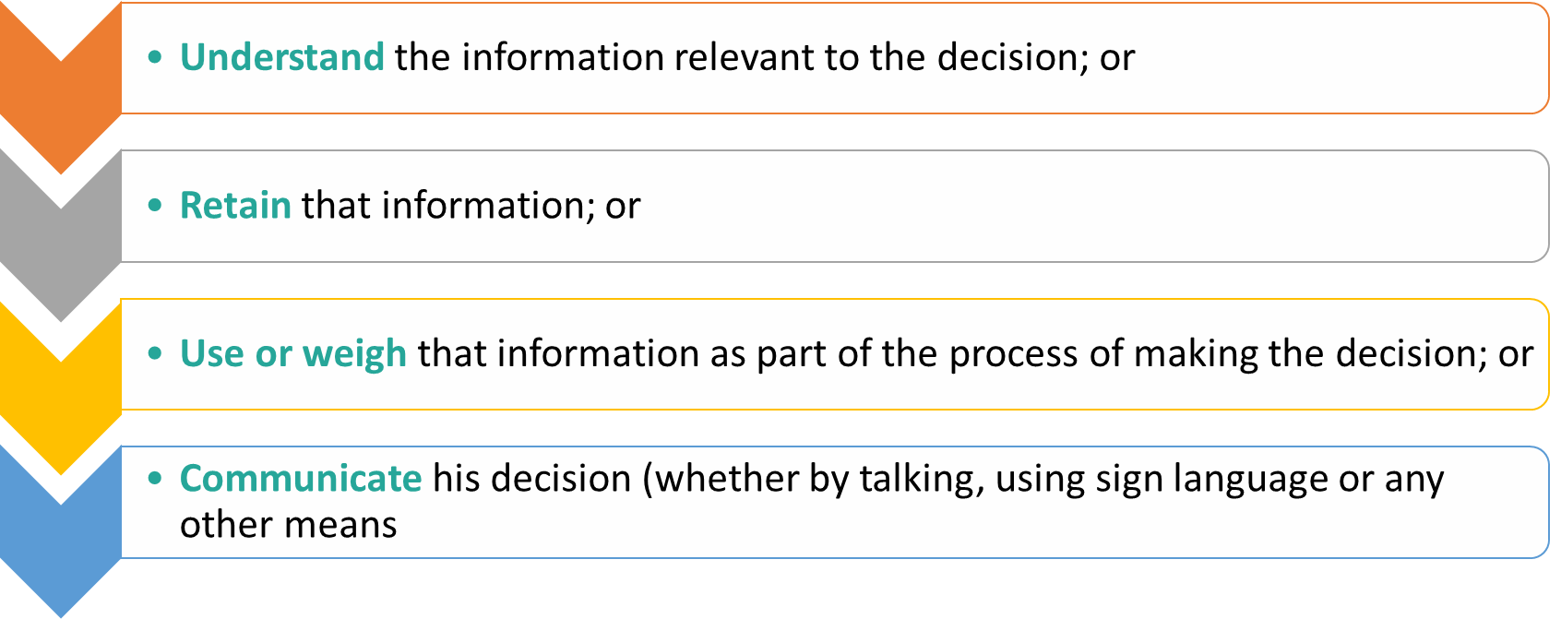
The Functional Test (s.3(1) MCA)
Notes:
Section 3 of the MCA states that the person is unable to make a decision for himself if he is unable:
• to understand the information relevant to the decision; or
• to retain that information; or
• to use or weigh that information as part of the process of making the decision; or
• to communicate his decision (whether by talking, using sign language or any other means)
If the person is unable to do one or more of those things, the law says they lack capacity to make the decision.
Remember:
We must not take a blanket approach – a person may lack capacity to make some decisions but not others, they may have capacity some of the time but not others (e.g. sundowning or where there is the impact of alcohol or drugs)
The burden of proof is on the Assessor NOT on the person.
The Assessment is made on the Balance of Probabilities (i.e. more likely than not).
Indecision should not be confused with incapacity -there are times when we all struggle to know what the right decision is, but this isn’t because we lack capacity to make a decision, it’s because we are human.
Complex capacity assessments where a consensus can’t be reached may need to be determined by the COP
Before you undertake the assessment it is necessary to advise the person explicitly that you are completing a capacity assessment L B Wandsworth v M & Ors (2017)

Slide 10
Identify the Specific Decision and the Relevant Information
‘The statement ‘P lacks capacity’ is, in law, meaningless. You must ask yourself “what is the actual decision in hand”? If you do not define this decision with specific precision before you start undertaking the assessment, the exercise will be pointless”.
P needs to decide between continuing her current tenancy at …................ or ending the tenancy and moving in with her sister. ​
P needs to decide whether to have support from carers with taking her prescribed medication, or not.
The relevant information: The information the person must be able to understand, retain, use and weigh to make the decision. ‘Not being clear about this is one of the single greatest causes of unnecessary complexity, difficulty and challenge’. (39 Essex Chambers)
Mental Capacity Guidance Note - Relevant Information for Different
Categories of Decision May 2024.pdf
Notes:
If a capacity assessment is required, we must first define the decision at hand. Capacity is decision specific. No-one simply “lacks capacity”.
A Local Authority v JB tells us that : ‘The statement ‘P lacks capacity’ is, in law, meaningless. You must ask yourself “what is the actual decision in hand”? If you do not define this decision with specific precision before you start undertaking the assessment, the exercise will be pointless”.
It’s important to look at the decision from the person’s perspective – what decision/s do they need to make? What options are they needing to decide between?
It’s also important to think carefully about whether you are actually asking the person to make more than one decision? If so, you need to separate these decisions out into separate decisions and assessments. Some decisions are so interlinked that it is difficult to separate them out, e.g. a decision whether to move to a residential home encompasses decisions regarding both residency and care.
It is vitally important to ensure that, having framed the question with sufficient precision to yourself, you actually then ask the Person the question (in whatever manner is appropriate) during the assessment (and record the answer). If, unusually, it is not appropriate to ask the precise question, the reasons why it was not asked should be spelled out carefully.
If you define the decision correctly, the relevant information the person needs for that specific decision will then flow from that.
So, once you’ve defined the decision, you need to identify the relevant information.
The relevant information is the information the person must be able to understand, retain, use and weigh to make the decision. 39 Essex Chambers advise that ‘Not being clear about this is one of the single greatest causes of unnecessary complexity, difficulty and challenge’.
Mental Capacity Act Code of Practice states relevant information includes “the nature of the decision”, “the reason why the decision is needed” and “the likely effects of deciding one way or another, or making no decision at all”
The relevant information is the different pieces of information that you need to evidence the person can understand, use and weigh etc in your assessment.
The relevant information is to be shared with the person, and the person should be supported to understand the relevant information. The person is not required to identify the relevant information themselves. We need to share information and support the person.
In order to demonstrate capacity, a person is not required or expected to consider every last piece of information in order to make a decision about the matter, but rather to have the broad, general understanding of the kind that is expected from the general population. – We really need to make sure we are supporting people and not expecting people to pass an assessment in exam conditions.
For some types of decisions, it may be important to give the person access to advice from elsewhere. This may be independent or specialist advice (for example, a medical specialist or legal adviser). It might simply be advice from trusted friends or relatives.
The 39 Essex Chambers guidance note linked on the slide pulls together the guidance given in relation to some of the most common categories of decisions that are encountered in practice, including such as: care, discharge from hospital, hoarding, medical treatment, residence, contraception, deprivation of liberty. This is really useful- we strongly recommend people access it to refer to the relevant information
So now we have talked about identifying the specific decision and the relevant information, we will recap assessing capacity.

Slide 11
The Functional Test for Assessing Mental Capacity
Notes:
To move back to the functional Test- We have a defined decision, we have identified the relevant information, this have been shared with the person in an accessible way.
We now apply the functional test- Understanding, retaining, use and weigh and communicating.
The first question of the function test is - Is the person able to understand the information relevant to the decision?
The person doesn’t have to understand every element of what is being explained to them. What is important is that they can understand the ‘salient factors’: the information relevant to the decision. This means that the onus is on you as the assessor not just to identify the specific decision but also what the information is relevant to that decision, and what the options are for the person to decide between.
The level of understanding required must not be set too high.
For example, if you were assessing a person’s ability to decide between living at home and living in a care home you would give the person information about what continuing to live at home would be like (e.g., what care package would be provided) and what living in an actual care home would be like. You would ‘paint a picture’ of the options for the person.
Is the person able to retain the relevant information?
“Retaining” should be cited only in relation to the ability to remember relevant information (capacityguide.org.uk)
The person needs to be able to retain enough information for a sufficient amount of time in order to make a decision.
The Act specifies that ‘the fact that a person is able to retain the information relevant to a decision for a short period only, does not prevent him from being regarded as able to make the decision.’ This is an important consideration, particularly when dealing with those with deteriorating memories.
Practicable Steps to aid retention of information could include using notebooks, photographs, voice recorders to help retain the information long enough to make the decision.
Is the person able to use the relevant information?
Using information involves being able to apply the information to the decision the person is facing in the real world. So, in some cases it is necessary to focus on whether the person can use the information ‘in the moment’ and, if not, whether that inability is because of mental impairment
In some cases, it may be difficult to identify whether the person is using a piece of relevant information but according it no weight or importance or whether they are failing to use the piece of information at all. Psychiatric expertise may be of assistance in such cases, as it may explain whether their ability to process information is impaired and if so, to what extent.
Is the person able to weigh the relevant information?
This aspect of the test has been described as ‘the capacity actually to engage in the decision-making process itself and to be able to see the various parts of the argument and to relate the one to another.’
As with understanding, it is not necessary for a person to weigh every detail of the respective options available to them, merely the salient factors.
Therefore, even though a person may be unable to weigh some information relevant to the decision in question, they may nonetheless be able to weigh other elements sufficiently to be able to make a decision.
Communicate
This section was only meant to apply to a very limited group of people, for instance those with locked-in syndrome, who may, despite all practicable steps, be unable to communicate. In such a situation, the law provides that we can then proceed in the name of the person’s best interests.
If you think that the person is unable to understand, retain, use or weigh relevant information, but it is clear that they are communicating something, then:
• The record of your assessment should not say that they are unable to communicate their decision – it should say that they are unable to make a decision, and what they are communicating are wishes and feelings;
• You should then take into account what they are communicating for purposes of constructing the best interests decision

Slide 12
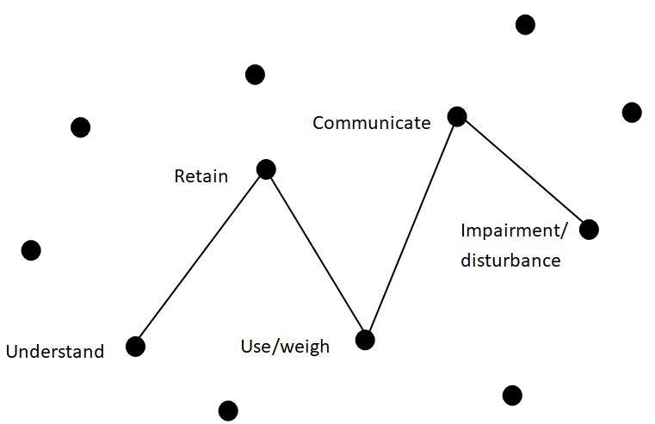

The Causative Nexus
Notes:
Once you have identified a person is unable to make a decision and identified an impairment or disturbance in the functioning of the mind or brain, YOU MUST NOW analyse and decide whether the inability to make the decision is because of the impairment. This is known as the “causative nexus” (PC and NC v City of York Council [2013] EWCA Civ 478).
Only where you can reasonably say that the person cannot make the decision because of the impairment of their mind can you say that they lack capacity to make the decision.
The causative nexus is a critical, often under-recorded part of a capacity assessment. It’s the legal “bridge” that connects the person’s impairment or disturbance of the mind or brain with their inability to make the specific decision.
Recording the Causative Nexus:
When recording causative nexus, generic statements such as “lacks capacity due to dementia” are not sufficient and risks unlawful practice. To meet the legal test, practitioners must explicitly connect the impairment to the decision-making difficulty. Clear, cause-linked recording protects the rights of the person and supports legally sound decision-making. Good recording includes phrases such as:
“Due to disorganised thought processes associated with schizophrenia, Mr. T was unable to use or weigh the risks and benefits of returning home.”
• “Because of the short-term memory loss caused by a recent stroke, Ms. K could not retain or recall the key information needed to make an informed decision about residency.”
• “Mr R has capacity: while his anxiety was high, it did not impair his ability to understand or weigh the decision.”

Slide 13
Recording
It is important to record the assessment, referring to:
Why the capacity assessment has come about- what are the concerns?
What the decision is, and the salient factors/relevant information.
What efforts have been made to support the person
Refer to each part of the functional test (understand, retain, use/weigh and communicate)
The use of verbatim quotes is strongly advised.
If there are concerns or questions about a person’s capacity and they are making ‘unwise’ decisions, it is important to document why you feel someone DOES have capacity
Notes:
Read slide
We will now move onto Executive functioning and fluctuating capacity.

Slide 14
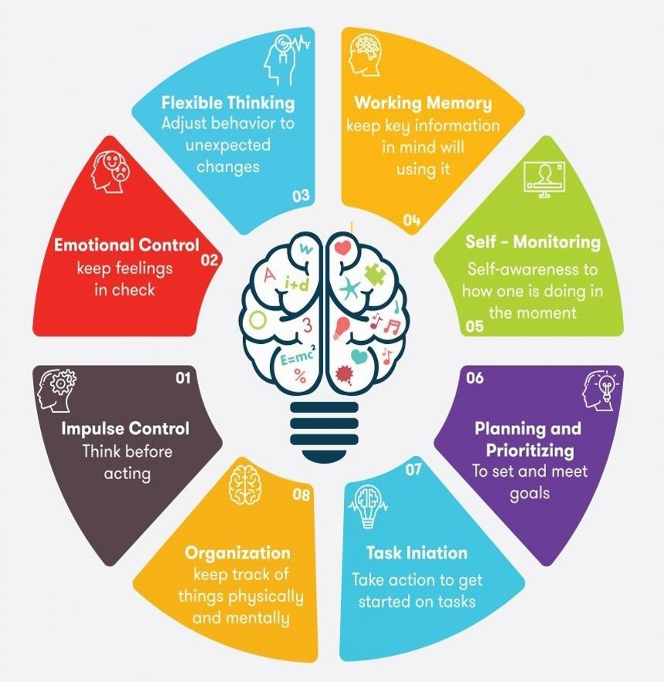
Executive Functioning
Executive functioning is not a standalone diagnosis. It is one of several cognitive areas that may be affected by an impairment or disturbance in the functioning of the mind or brain.
Executive function is a self-management system of the brain that allows for organising, planning, focusing, and managing emotions
Executive dysfunction can arise within a wide range of clinical conditions- including acquired brain injury, neurodegenerative disease and mental health disorders.
Notes:
Both these topics are complex and could fill a session in their own right. I will briefly cover them and then we will explore the issues further in the case studies and discussions.
Executive function issues/challenges/disorder isn’t a specific diagnosis in the DSM-5 (the manual used by clinicians for diagnosing conditions). it is something that may be referred to when there are difficulties with a person’s decision making that are harder to ‘label’- i.e. if a person cannot remember information this is easier to identify that higher level reasoning difficulties.
Executive function is a self-management system of the brain that allows for organising, planning, focusing, and managing emotions. It develops rapidly in preschool years but continues to develop throughout school and beyond, maturing for most people around 20 to 25 years old.
It includes lots of different skills including (read bullet pointed ones)
Planning- selecting a goal
Persistence toward a goal- capacity to maintain the drive to follow through to completion, ability to inhibit responding to distractions mid-task
Organising- arranging sequences of steps to meet goal
Working Memory & Recall -holding plans/steps in mind while acting, remembering, thinking forwards and backwards
Time management-awareness of time, setting priorities, acknowledgement of deadlines
Response inhibition- managing impulses and being able to thinking before you act,
Emotional Control- management of emotions
Monitoring-self-monitoring/evaluation
Sustained Attention- sustaining attention over time despite competing distractors or lack of interest
Task initiation/activation- ability to start a series of behaviours
Flexibility/shifting– shifting attention and mental set, changing of behaviour as needed, ability to see problems from different viewpoints
Issues with executive functioning are often linked to the term ‘can talk the talk, but not walk the walk’- so someone knows what are expected or reasonable responses and will often have a set of ‘learnt’ or stock phrases/responses linked to a subject. In this situation people can often talk about a subject, but their day-to-day actions don’t correlate with what they say.
(*If anyone asks: DSM-5: Diagnostic and Statistical Manual of Mental Disorders 5th edition)

Slide 15
Fluctuating Capacity
Fluctuating capacity is where a person’s ability to make decisions or process information varies over time.
This fluctuation can take place either:
over a matter of weeks or months.
or over the course of days
or over the day
One off decisions: You may be able to delay taking the decision until the impact of the person’s condition upon their decision-making abilities has diminished. If it is not possible to put the decision off, then you should either take the minimum action necessary pending the person regaining decision-making capacity or you should move to best interests decision making.
Notes:
Some people’s ability to make decisions fluctuates, or changes, because of the nature of a condition that they have.
This fluctuation can take place either over a matter of weeks or months (for instance where a person has bipolar disorder with cycles of mania, depression or mixed states)
or over the course of days (for instance a person with delirium with states of confusion such as if someone has a severe infection)
or over the day (for instance a person with dementia whose cognitive abilities are significantly less impaired at the start of the day than they are towards the end).
Fluctuation of mental state does not necessarily entail fluctuating capacity – symptoms (e.g. mood and anxiety symptoms) may be highly changeable without necessarily causing changes to a person’s ability to make decisions.
If it is a one-off decision, you may be able to delay taking the decision until the impact of the person’s condition upon their decision-making abilities has diminished.
If it is not possible to put the decision off, then you should either take the minimum action necessary pending the person regaining decision-making capacity or you should move to best interests decision making.
At the point when mental capacity has been regained, you should record the person’s decision, you may also want to record why you consider that the person had capacity to make it, (in case this is later challenged).
Depending upon the context, you should also record the discussions held and what the person would want in the event that they lose capacity in future to make similar decisions. This means that, if further decisions then need to be taken in their best interests, they can be taken in knowledge of what they would want.

Slide 16
Fluctuating Capacity- repeated or continual decisions
Some decisions are not one-off and need to be repeated or continue over a period of time.
This means the ‘material time’ for the decision is longer.
Examples include the management of property and affairs, or the management of a physical health condition which requires a multitude of ‘micro decisions’ over the course of each day.
Fluctuating capacity – another judicial take – Mental Capacity Law and Policy
Notes:
Some decisions are not one-off and need to be repeated or continue over a period of time. So the ‘material time’ for the decision is longer. Examples include the management of property and affairs, or the management of a physical health condition which requires a multitude of ‘micro-decisions’ over the course of each day.
Although capacity is time-specific, in such a case, it will usually be appropriate to take a longer view as to the ‘material time’ during which the person must be able to take the decisions in question.
The courts have shown themselves increasingly willing to take this longitudinal approach, or the closely related ‘macro-decision’ approach.
There is a link on the slide to an article on the Mental Capacity Law and Policy website, which talks through a judicial ruling which includes fluctuating capacity.
There are further links in the resources slides at the end relating to both executive functioning and fluctuating capacity

Slide 17
Breakout Rooms and Discussions
Scenario 1- Elizabeth
Elizabeth is living alone in a small, rented bungalow. She has progressive COPD, long‑term alcohol dependence, and a history of trauma. Recently, she has been struggling with mobility and breathlessness.
Concerns: Falls, medication, refusing care, gas safety and possible eviction. Recent fall- Paramedics unsure if she had mental capacity to refuse admission.
Scenario 2- Omar
Omar sustained a traumatic brain injury (TBI) following a road traffic accident. He lives alone in a council flat and is known to community neuro-rehabilitation services. He takes anti‑seizure medication and medication for anxiety. Neighbour supports him.
Concerns: Medication, financial vulnerability and possible financial abuse, excessive charitable donations.
Scenario 3- Peter
Peter has a diagnosis of Korsakoff’s syndrome secondary to long‑term alcohol dependence. He has been street homeless for several years. He was brought into hospital with severe dehydration and a chest infection. Now medically stable, the ward team feels he is ready for discharge.
Concerns: He wants to return to being street homeless, impact on health, possible exploitation, high mortality risk.

Slide 18

Questions for each case study:
1. What is/are the specific decision(s) the person is needing to make?
2. What practicable steps could you take to support the person to make their own decision(s)?
3. Who is best placed to provide the relevant information and to complete the mental capacity assessment.
(if there is more than 1 decision, list separately for each specific decision being made)
4. If you were completing the capacity assessment, what are the most important factors to consider?

Slide 19

Feedback
Please complete the short feedback form- It helps us evaluate the session and plan future events
CSAB Practitioner Forum - Wednesday 15th April 2026 – Fill out form
Notes:
Please complete the feedback while we talk through the resources…
CSAB Practitioner Forum - Wednesday 15th April 2026 – Fill out form

Slide 20
References and resources
Mental Capacity Guidance Note: Assessment and Recording of Capacity (39 Essex Chambers) Mental Capacity Guidance Note: Assessment and Recording of Capacity | 39 Essex Chambers
Mental Capacity Guidance Note: Relevant Information for Different Categories of Decision (39 Essex Chambers) MENTAL CAPACITY GUIDANCE NOTE: RELEVANT INFORMATION FOR DIFFERENT CATEGORIES OF DECISION | 39 Essex Chambers
Social Care Institute for Excellence – MCA in practice https://www.scie.org.uk/mca/practice
Capacity Guide website Home - Capacity guide
Alex Ruck Keene, Mental Capacity law and policy- Shedinars – Mental Capacity Law and Policy-
NICE Decision-making and mental capacity implementation resource Implementation resource to help put the NICE guideline ‘Decision making and mental capacity’ (NG108) into practice.
Notes:
Note Alex Ruck Keene shedinars- useful resource and accessing short videos and you can access the slides from the talks as well.
Social Care Institute for Excellence- SCIE have lots of great resources.

Slide 21
References and resources
Executive dysfunction under the judicial spotlight – Mental Capacity Law and Policy
Communicating the communication limb of the capacity test – Mental Capacity Law and Policy
Fluctuating capacity – another judicial take – Mental Capacity Law and Policy
Research in Practice – Mental Capacity Act 2005 decision-making – care, support and treatment Practice Tool (https://www.researchinpractice.org.uk/adults/publications/2021/april/decision-making-under-the-mental-capacity-act-2005-practice-tool-2021/
Case Law and Legal Summaries for social care practice | Research in Practice monthly case law updates, highlighting implications for practice
Mental Capacity Act 2005 - resources | Cumbria Safeguarding Adults Board
Legislation section of the Practice Library (Cumberland ASC practitioners)
Richards S, Mughal AF Deprivation of Liberty Safeguards (DoLS) Handbook 2nd Edition
Notes:
Research in Practice also have quite a lot of resources and webinars- some things available to all, some of them will need you to have an account- ASC staff will have this, but other staff may not be able to access some things, but still worth a look
The practice library is an internal resource for Cumberland ASC&H staff.

Slide 22

Thank you!
Notes:
Lastly, thanks to everyone for joining us today, we hope the session has been useful for you.
There are future CSAB session planned ** check any dates** and there is a CSAB newsletter that you can sign up to- link in the chat.

Slide 23


